Slide 1
BC3413/3407
(2024 S2)
Notes:
<!DOCTYPE html>
<html lang="en">
<head>
<meta charset="UTF-8">
<link rel="stylesheet" type="text/css" href="/static/styling.css">
<style>
p {
font-family: "Bookman Old Style";
font-size: medium;
color: #9C1A1C;
}
.myClass {
background-color: #dddddd;
}
.h1_style {
color: chocolate;
border: 2px solid yellow;
padding: 20px;
width: 100px;
}
.leftbox {
width: 100px;
height: 200px;
background-color: #97bfff;
}
.rightbox {
position: absolute;
left: 150px;
top: 10px;
width: 500px;
height: 400px;
background-color: chartreuse;
}
a {
color: cadetblue;
}
a:hover {
background-color: black;
}
ul {
background-color: beige;
}
.smallbox {
background-color: lightslategray;
width: 60px;
height: 20px;
}
</style>
<title>Title</title>
</head>
<body>
<div class="myClass">
<div class="leftbox">
<p>my other content....</p>
</div>
<div class="rightbox">
This is the right box
<ul>
<div class="smallbox">
<li><a href="">Link 1</a></li>
</div>
<li><a href="">Link 2</a></li>
<li><a href="">Link 3</a></li>
</ul>
</div>
{% for each in data[1:] %}
<p>
{{ each}}
</p>
{% endfor %}
</div>
</body>
</html>

Slide 2
Lesson 1 Recap - See speaker notes
S
def task1_summing_numbers(numbers):
total = 0 # initialize a total variable
for index, data in enumerate(numbers):# for loop to loop through the index and number
if index % 2 == 0:# if the current index is even index 0, 2, 4...
total += data # add the number to total
print("..adding ", data)
print("The total is ", total)
return total# return the total
num_list = [21, 2, 56, 70, 80, 40, 21, 18]
task1_summing_numbers(num_list)
def task2_keyword_search():
string_list = []
user_input = input("Enter a sentence:")# prompt user for sentence input
keyword = "fake" # initilize a string keyword containing "fake"
filtered_list = [] # initilize another filtered_list starts with empty list
while len(user_input) > 0:
string_list.append(user_input)# append the sentence to string_list
if keyword in user_input:# if keyword in the sentence
filtered_list.append(user_input)# append to filtered list
user_input = input("Enter a sentence:")# prompt for user input again
print("The string containing keywords:", filtered_list)
task2_keyword_search()
def task3():
# initialize the string_text variable
# split the string_text into list and keep in a list var
# initialize vowels list var
# initialize consonant list var
# loop through the string_text
# if current word first letter in aeiouAEIOU
# append current word to vowels list
# else
# append to consonant list
# Task 4
test_string = "Python can mix and match." text_list = test_string.split() # split by spacing text_length = [] for each in text_list: text_length.append((each, len(each))) print("The word and length pairs: ", text_length)
Notes:
print("Hello!")
print([11, 22, 33])
# how to get 22?
print([11, 22, 33][1]) # 22
# how to get [22, 33]
print([11, 22, 33][1:])
print((100, 200, 300))
print((100, 200, 300)[1]) # 200
print({"a":100, "b":200})
# how to get 200?
print({"a":100, "b":200}["b"])
# how to get ["a", "b"]
print({"a":100, "b":200}.keys()) # ["a", "b"]
print(list({"a":100, "b":200}.keys())[0])
list_data = [11, 22, 33]
for each in list_data:
print(each) # 11
for index in range(len(list_data)):
print(index, list_data[index]) #0, 11
for index, data in enumerate(list_data):
print(index, data) # 0, 11
def mix_n_match(data1, data2): #[11, 22], (100, 200) input arguments
data_result = []
for index in range(len(data1)):
data_result.append(data1[index] + data2[index])
return data_result
print(mix_n_match([9, 8], (6, 5)))

Slide 3
Lesson 2 - Demo
import requests, webbrowser
url = "https://pokeapi.co/api/v2/pokemon/"
response = requests.get(url)
poke_data = response.json()
# check the data type of poke_data
print(poke_data['results'])# retrieve the name and url of pokes from ‘results’ key.
poke_names_url = {} # create a dictionary to keep the key and url.
for each in poke_data['results']:
poke_names_url[each['name']] = each['url']
while True:# while loop to run the menu continuously
menu = "Welcome to the world of Poke!\n"# Welcome message
count = 1
for name in poke_names_url.keys():# for loop to loop through the names of poke
menu += f"{count:3}. {name:13}" # "{:10}".format(var)
if count % 5 == 0:
menu += "\n"
count += 1
print(menu)#, end="\n")
selection = input("Enter the name of poke:")
print(f"You have selection {selection}, you can see the details from {poke_names_url[selection]}")
input("Press enter to open in browser...")
webbrowser.open(poke_names_url[selection])
if input("Continue? Y/N") == "N":
break
def split_text(sentence):
sentence = sentence.replace(",", "")
sentence = sentence.replace(".", "")
vowels = []
consonants = []
for word in sentence.split():
word = word.lower()
if word[0] in "aeiou":
vowels.append(word)
else:
consonants.append(word)
return vowels, consonants
sentence = input("Enter a sentence:")
name = input("Your name pls:")
vowels, consonants = split_text(sentence)
files_data = {
f"{name}_vowels.txt": vowels,
f"{name}_consonant.txt": consonants
}
for file, data in files_data.items():
with open(file, "w") as fp:
print("\n".join(data), file=fp)
# Task 3
import json
filename = "humidity.txt"
with open(filename, 'r') as file:
with open("humidity_json.json", "w") as j_file:
data = file.readlines()
humidity = {}
for index, line in enumerate(data):
period, percent = line.strip().split()
if index == 0:
humidity['name'] = "Humidity Data"
humidity['meta'] = {
'Period': period,
'Percent': percent
}
humidity['data'] = []
else:
humidity['data'].append({
'period': period,
'percent': percent
})
json.dump(humidity, j_file, indent=4)
Notes:
"""
Demo: Create a simple program to print timetable to file.
1 * 2 = 2
....
"""
try:
number = int(input("Enter a number for timetable:"))
for j in range(2, number+1):
with open(f"timetable_{j}.txt", "w") as fp:
for i in range(1, 11):
print(f"{i} * {j} = {i * j}", file=fp)
except ValueError:
print("The number is not valid.")

Slide 4
Week 3 - Demo
import requests
from bs4 import BeautifulSoup
import pandas as pd
#
# with open("Week3_page1.html", "r") as r:
# soup = BeautifulSoup(r.read(), 'html.parser')
# print(soup.find("p"))
# print(soup.find("p"))
url = "https://www.channelnewsasia.com/"
r = requests.get(url)
soup = BeautifulSoup(r.content, 'html.parser')
# Utilize find_all to get the relevant tags from html file.
# <type class=“class_name”> From the name of tags, fill in the relevant tags information below.
"""
<h6 class="h6 list-object__heading">
<a class="h6__link list-object__heading-link" href="/singapore/pm-lawrence-wong-deliver-singapore-2025-budget-statement-parliament-feb-18-4912286">
Singapore’s 2025 Budget statement to be delivered on Feb 18 at 3.30pm
</a>
</h6>
"""
# Signature: find_all(name, attrs, recursive, text, limit, **kwargs)
data= soup.find_all("h6", "h6 list-object__heading")
#print(data)
# print(data) # Take a look at the output before proceed.
count = 1
for each in data: # loop through all data
# Get text from tag
each_title = each.text # Get the text information from each title.
print(f"{count}.{each_title.strip()}")# print out the title one by one
count += 1
Notes:
<!DOCTYPE html>
<html lang="en">
<head>
<meta charset="UTF-8">
<title>My First Webpage</title>
<style>
.redstyle {
color: red
}
</style>
</head>
<body>
<h1>Header 1</h1>
<h2>Header 2</h2>
<p class="redstyle">This is for text paragraph</p>
<p>This is for another paragraph</p>
<ol>
<li>First item in ol</li>
<li>Second item</li>
</ol>
<ul>
<li>First bullet</li>
<li>Second bullet</li>
</ul>
<a href="https://www.channelnewsasia.com/">News Link</a>
</body>
</html>
—-------------------------------------------------------------
import requests
from bs4 import BeautifulSoup
with open("Week3_page1.html", "r") as r:
soup = BeautifulSoup(r.read(), 'html.parser')
print(soup.find("p"))
print(soup.find("p"))

Slide 5
Web Scraping - Task 2
import requests
from bs4 import BeautifulSoup
import pandas as pd
url = "https://www.courts.com.sg/computing-mobile/tablets"
r = requests.get(url)
soup = BeautifulSoup(r.content, 'html.parser')
#%%
# price = soup.find_all('span')
df = pd.DataFrame({})
# Tags for product title: <h3 class="product name product-item-name" style="height: 129px;">
product_title = soup.find_all("h3", "product name product-item-name")
print(product_title)
product_titles = []
for title in product_title:
# Get info from tag
each_title = title.text.strip()
product_titles.append(each_title)
#%%
product_price_divs = soup.find_all("div", "price-box price-final_price") product_prices = []
for div in product_price_divs: # loop through all product titles each_price = div.find("span", "price-wrapper") print(each_price.get("data-price-amount")) product_prices.append(each_price) # append each title to the list. product_prices

Slide 6
Web Scraping - Task 2 (cont’)
def get_soup(url):
r = requests.get(url)
soup = BeautifulSoup(r.content, 'html.parser')
return soup def get_products(soup, tagname, classname, result):
for each in soup.find_all(tagname, classname):
result.append(each.text.strip())
return result
def get_prices(soup, tagname, classname, subtag, subclass, attributename, result):
for each in soup.find_all(tagname, classname):
tag = each.find(subtag, subclass)
result.append(float(tag.get(attributename)))
return result
web_url = "https://www.courts.com.sg/computing-mobile/laptops/windows-laptop"
soup = get_soup(web_url)
tagname = "h3"
classname = "product name product-item-name"
result = []
result= get_products(soup, tagname, classname, result)
tagname = "div"
classname = "price-box price-final_price"
subtag = "span"
subclass = "price-wrapper"
attributename = "data-price-amount"
result_prices = []
result_prices = get_prices(soup, tagname, classname, subtag, subclass, attributename, result_prices)
print(len(result), result)
print(len(result_prices), result_prices)
#%%
product_titles = [] prices = [] for page in range(2,4): url = " https://www.courts.com.sg/computing-mobile/tablets?p= " + str(page) soup = get_soup_from_url(url) product_titles = get_titles(soup, product_titles) prices = get_prices(soup, prices) df = pd.DataFrame({}) df['product_titles'] = product_titles df['each_price'] = prices #%% df.to_csv(”tablet_prices.csv")

Slide 7
Week 5- OOP Demo
class Person:
def __init__(self, name, email=""):
self.name = name
self.email = email
def introduction(self):
print(f"I'm {self.name}, email:{self.email}")
def __str__(self):
return f"{self.name} string representation."
class Student(Person):
def __init__(self, name="", matric="", email=""):
super().__init__(name, email)
self.matric = matric
def __str__(self):
return f"I'm a full time student {self.name}, matric={self.matric}"
#############################################################
john = Person("John")
john.introduction()
mary = Person(name="Mary", email="mary@gmail.com")
mary.introduction()
print(type(mary), mary)
print(john)
jimmy = Student("Jimmy", matric="U201729A")
print(jimmy)
Notes:
import csv
with open("news.csv", "r", encoding="utf-8") as f:
csv_pointer = csv.reader(f)
for line in csv_pointer:
print(line)

Slide 8
Week 5 - OOP Cont (Task 2)
class News:
def __init__(self, news):
self.news_headline = news[0]
self.news_article = news[1]
self.news_category = news[2]
self.full_text = news[3]
self.clean_text = news[4]
self.words = len(self.full_text)
def __str__(self):
return f"<{self.words} words> in {self.news_category}: {self.news_headline} "
class FinanceNews(News):
def __init__(self, news):
# Symbol,news_headline,news_article,news_category,full_text,clean_text
super().__init__(news[1:])
self.symbol = news[0]
def __str__(self):
return f"{self.symbol}, <{self.words} words> in {self.news_category}: {self.news_headline} "
import csv
news_instances = []
with open("news.csv", "r", encoding="utf-8") as f:
csv_pointer = csv.reader(f)
line_no = 0
for line in csv_pointer:
if line_no != 0:
news_obj = News(line)
news_instances.append(news_obj)
line_no += 1
with open("finance_news.csv", "r", encoding="utf-8") as f:
csv_pointer = csv.reader(f)
line_no = 0
for line in csv_pointer:
if line_no != 0:
news_obj = FinanceNews(line)
news_instances.append(news_obj)
line_no += 1
for i in range(5):
print(news_instances[i])
for i in range(5):
print(news_instances[-i])
Notes:
class News:
def __init__(self, news):
self.news_headline = news[0]
self.news_article = news[1]
self.news_category = news[2]
self.full_text = news[3]
self.clean_text = news[4]
self.words = len(self.full_text)
def __str__(self):
return f"<{self.words} words> in {self.news_category}: {self.news_headline} "
class FinanceNews(News):
def __init__(self, news):
# Symbol,news_headline,news_article,news_category,full_text,clean_text
super().__init__(news[1:])
self.symbol = news[0]
def __str__(self):
return f"{self.symbol}, <{self.words} words> in {self.news_category}: {self.news_headline} "
import csv
news_instances = []
with open("news.csv", "r", encoding="utf-8") as f:
csv_pointer = csv.reader(f)
line_no = 0
for line in csv_pointer:
if line_no != 0:
news_obj = News(line)
news_instances.append(news_obj)
line_no += 1
with open("finance_news.csv", "r", encoding="utf-8") as f:
csv_pointer = csv.reader(f)
line_no = 0
for line in csv_pointer:
if line_no != 0:
news_obj = FinanceNews(line)
news_instances.append(news_obj)
line_no += 1
for i in range(5):
print(news_instances[i])
for i in range(1,6): # revision, last 5 news
print(news_instances[-i])

Slide 9
Week 6 - OS & DB
import random
print(random.randrange(3000, 6000))
# Discuss at 11:15
salaries = [random.randrange(3000, 6000) for salary in range(50)]
salaries_high = [salary for salary in salaries if salary > 4500]
salaries_high_format = [f"${salary:,.0f}" for salary in salaries if salary > 4500]
print("Salaries:", salaries)
print("Selected Salaries: ", salaries_high_format)
import sqlite3
# establish connection
conn = sqlite3.connect("salaries.db")
# get cursor
cursor = conn.cursor()
# SQL
SQL_stmt = "SELECT * FROM salaryTable;"
cursor.execute(SQL_stmt)
for each in cursor.fetchall():
print(each[:2])
Notes:
# SQL TASK 3
import sqlite3
# establish connection
conn = sqlite3.connect("salaries.db")
# get cursor
cursor = conn.cursor()
# SQL
"""
a. Executives who earn more than $1m.
SQL = "SELECT * FROM salaryTable WHERE Salary > 1000000;"
b. Company names in the industry of Health Care
SQL = "SELECT CompanyName FROM salaryTable WHERE CompanyType = 'Health Care';"
c. Executives who earn more than $1m and in the Utilities industry.
SQL = "SELECT * from salaryTable where salary > 1000000 and CompanyType = 'Utilities';"
d. Which executive received the highest salary?
SQL = "SELECT * from salaryTable order by Salary desc limit 1;"
SQL = "SELECT CONCAT(ExecutiveLName, ' ', ExecutiveFName), Salary FROM salaryTable WHERE Salary = (SELECT MAX(Salary) FROM salaryTable);"
"""
SQL = "SELECT CONCAT(ExecutiveLName, ' ', ExecutiveFName), Salary FROM salaryTable WHERE Salary = (SELECT MAX(Salary) FROM salaryTable);"
cursor.execute(SQL)
for each in cursor.fetchall():
print(each)

Slide 10
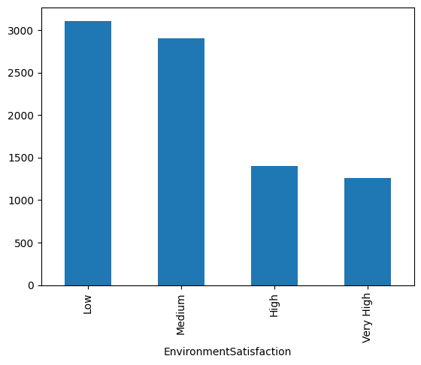
Group 7
df = pd.read_csv("employee.csv")
# records, cols
print("records, cols:", df.shape)
# duplicates
print("duplicates:", df[df.duplicated()].shape[0])
# same employee No.
print("same employee no.:", df[df['EmployeeNumber'].duplicated()].shape[0])
# null records
print("null records:", df[df.isna()].shape[0])
records, cols: (8687, 37)
duplicates: 14
same employee no.: 31
null records: 8687
conversion_rate = 1.35
df['DailyRate_SGD'] = list(map(lambda x:x*conversion_rate, df['DailyRate']))
df['WorkLifeBalance']=df["WorkLifeBalance"].map({1:"Bad", 2:"Good", 3:"Better", 4:"Best"})
df[df["MonthlyIncome"] == "Married"]["MonthlyIncome"]
Monthly Income contains Married
Low Environment satisfaction

Slide 11
Group 3
Task 2
Q1 - 8687
Q2 - 37
Q3 - 14
Q4 - 31
Q5 - 139
Workings:
df.shape #No. of records, no. of columns
df.duplicated().sum() #no. of duplicated records
df.EmployeeNumber.duplicated().sum() #no. of duplicated Employee Number
df.isna().sum().sum() #no. of missing records

Slide 12
Group 6
Q1
8687 records
Q2
37 columns
Q3
14 duplicated records
Q4
31 records with same EmployeeNumber
Q5
employee.isna().sum()

Slide 13
Group 4
print(len(df))
#8687
print(df.shape[1])
#37
print(df.duplicated().sum())
#14
print(df.EmployeeNumber.duplicated().sum())
#31
print(df.isna().sum())

Slide 14
Group 4
8687 records
37 columns
14 duplicated records
31 duplicated records with same EmployeeNumber
139 null records
num_records = df1.shape[0]
print(num_records)
num_columns = df1.shape[1]
print(num_columns)
num_duplicated_records = df1.duplicated().sum()
print(num_duplicated_records)
num_duplicated_employee_numbers = df1.duplicated(subset=["EmployeeNumber"]).sum()
print(num_duplicated_employee_numbers)
num_null_records = df1.isnull().sum().sum()
print(num_null_records)

Slide 15
Group 8
import pandas as pd
df = pd.read_csv("employee.csv")
Df
print("Number of rows:", len(df))
8687
print("Number of columns:", len(df.columns))
37
duplicate_rows = df[df.duplicated()]
print(duplicate_rows)
print("Number of duplicate rows:", len(duplicate_rows))
14
duplicate_id = df["EmployeeNumber"].duplicated()
print(duplicate_id)
print("Number of duplicate EmployeeNumbers:", duplicate_id.sum())
31

Slide 16
Group 2
import pandas as pd
Task 2:
df = pd.read_csv("employee.txt")
df
# 1. Number of records
num_records = df.shape[0]
# 8687 records, 37 columns
# 2. Number of columns
num_columns = df.shape[1 ]
#37
# 3. Number of fully duplicate
num_exact_duplicates = df.duplicated().sum()
# 14
# 4. Number of rows that share the same EmployeeNumber
num_dup_empnumber = df["EmployeeNumber"].duplicated().sum()
#31
# 5. Missing values
missing_by_column = df.isna().sum() # Missing values per column
total_missing = missing_by_column.sum() # Total missing values
# Number of null records: 139

Slide 17
Group 5
# 1. How many records are there in this data file?
# Ans: 8687
# 2. How many columns are there in this data file?
# Ans: 37
# 3. Any duplicated records (records with all columns same values)? How many of them?
# Ans: 14
# 4. Any records with the same EmployeeNumber? How many of them?
# Ans: 31
# 5. Are there any null records? If so, how many of them?
# Ans: 139

Slide 18
Week 7 - Employee.csv
See speaker notes
Notes:
import matplotlib.pyplot as plt
import seaborn as sns
import pandas as pd
df = pd.read_csv("employee.csv")
pd.set_option("display.max_rows", None)
pd.set_option("display.max_columns", None)
print(df)
####################
fig, ax = plt.subplots()
df.plot(kind="box", y="DailyRate", ax=ax)
fig.savefig("DailyRate.jpg")
######################
sns.countplot(data=df, x="Attrition", hue="Education", ax=ax)
fig.savefig("attrition.jpg")
########################
sns.countplot(data=df, x="Attrition", hue="EnvironmentSatisfaction")
########################
df.EnvironmentSatisfaction = df.EnvironmentSatisfaction.map({1: "Low", 2:'Medium', 3: 'High', 4: 'Very High'})
sns.countplot(data=df, x="Attrition", hue="EnvironmentSatisfaction")

Slide 19
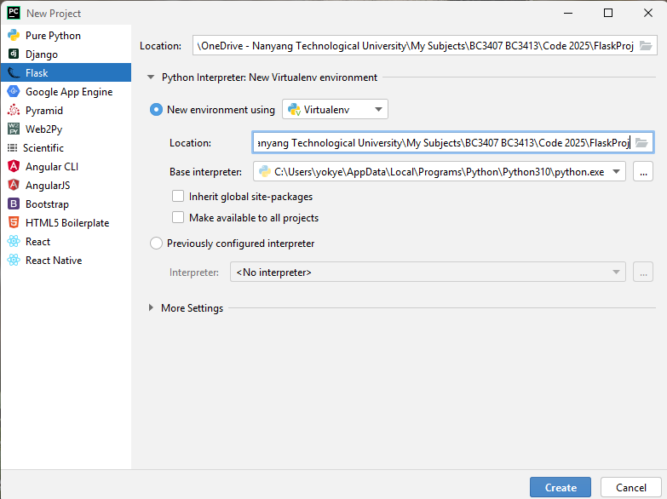
Web Programming - Flask

